Slide 1
AS91896(2.7) & AS91887(2.8) Documentation
Samuel Burgess

Slide 2
AS-2.7-2.8 Monster Cards
Link to GitHub Repository: https://github.com/Samuel-Burgess/2.7-2.8-Assesment-Monster-Card-CatalogueLinks to Trello board / project management tools: https://trello.com/b/KBUnldZT/assesment-2023-monster-card
Link to final version of your program: [here]
Ensure you have made these links ‘public’ so that they are open to anyone, including the marker. The link to your program is the final outcome of this whole project – your finished program.

Slide 3
Explain relevant Implications:
Additional rows can be added by clicking in the last cell and then using the Tab key
Relevant implication | Explain the implication and say how it is relevant to this project
Functionality | Functionality is making sure the program works as expected. For example, if my program asks how powerful a card should be, it should work on an expected input like 2, boundary input like 1, and not crash on an unexpected input like 0.2
Usability | Usability is about how easily usable the program is to the end user, e.g. making error messages clear, showing what inputs to use ect.
Aesthetics | How the program looks, eg well spaced code, prompts, and decoration around key messages
Future proofing | Easily modifiable, using comments to describe what is happening in the code
Notes:
Additional rows can be added by clicking in the last cell and then using the Tab key

Slide 4
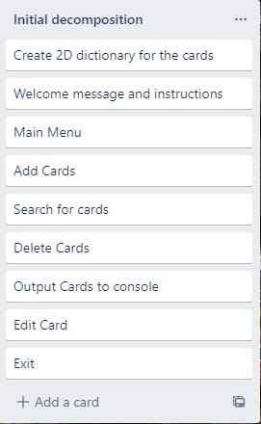
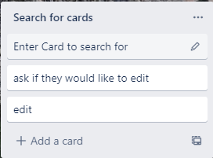
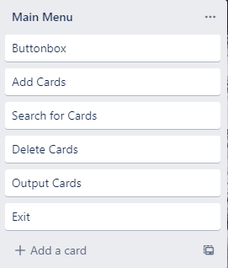
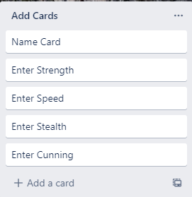
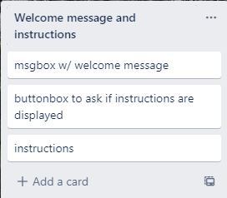
Decomposition:
Notes:
Paste screenshots of your initial Trello board / task decomposition on this slide. If you have a long list, you might need to break it up into several slides.

Slide 5
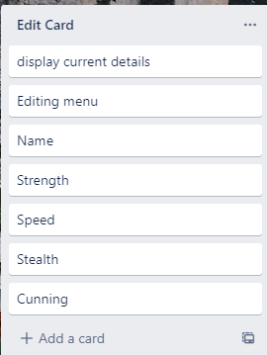
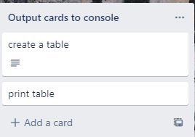
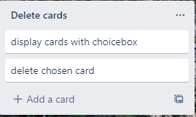
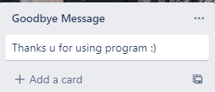
Decomposition cont.

Slide 6
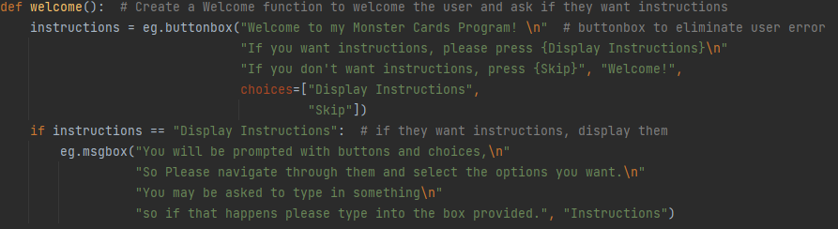
Welcome() function (Trello screenshot)

Slide 7
Testing from peers
Midway through the project I had a peer test the program and tell me that it was hard to understand what was happening, so I updated my instructions and made messages clearer to read.

Slide 8
Welcome() function - Test Plan
Additional rows can be added by clicking in the last cell and then using the Tab key
Test Cases - input | Expected output
Display instructions | Instructions displayed
Skip | No instructions displayed
Exit | Popup does not exit
Notes:
Additional rows can be added by clicking in the last cell and then using the Tab key

Slide 9
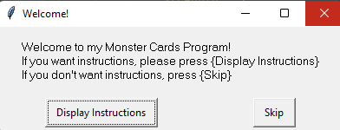
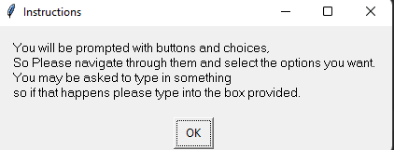


Welcome() function: Testing
When I asked for instructions to be displayed, they were, when I didn’t wasn't them displayed, they weren’t, and I couldn’t exit the popup, so everything is working as intended – Note – Instructions have since been updated
Notes:
You must show the results of testing. For each component, include a screenshot proving it works. You can also include notes about each test.

Slide 10
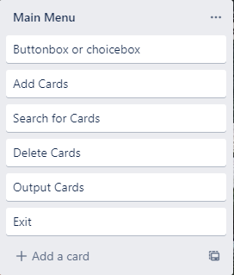
Main Menu (Trello screenshot)

Slide 11
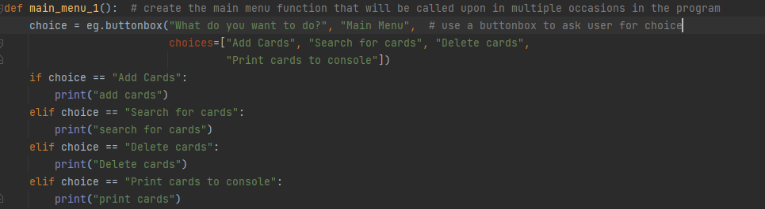
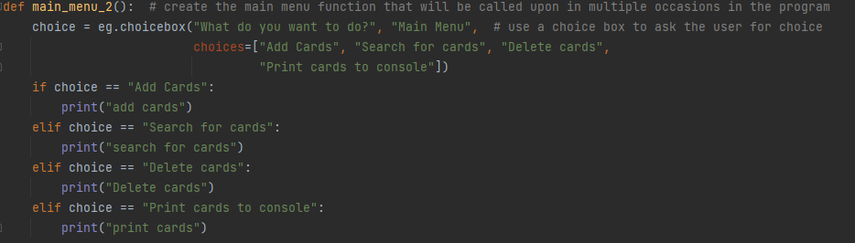
Main Menu: Trialling
I decided that I would either use a button box or choice box for the main menu, and so I trialled both.
Notes:
NOTE: Trialling needs to happen for at least 2 of your components but is not necessary for ALL components.
Trialling is not the same as testing. Trialling is about finding different ways of building the same component. Show evidence of your trialling here. Select one of your trials for further development and give reasons for your choice.

Slide 12
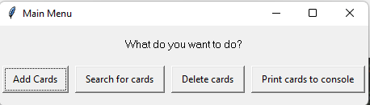
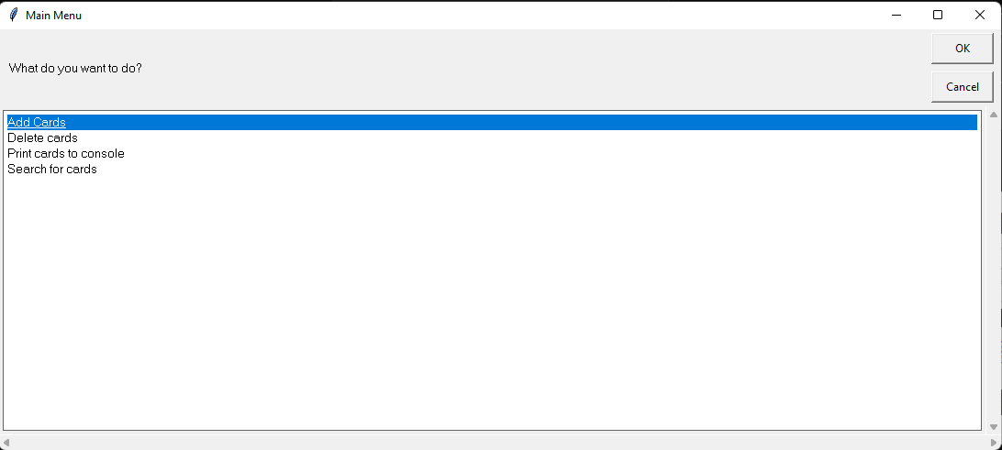
Main Menu: Trialling
Here we can see both in action, and I believe the button box looks better. They both are the same length and efficiency in the code, so I will base my decision to use the button box over the choice box purely on aesthetics
Notes:
NOTE: Trialling needs to happen for at least 2 of your components but is not necessary for ALL components.
Trialling is not the same as testing. Trialling is about finding different ways of building the same component. Show evidence of your trialling here. Select one of your trials for further development and give reasons for your choice.

Slide 13
Main Menu - Test Plan
Test Cases - input | Expected output
Add Cards | Add cards
Search for cards | Search for cards
Delete cards | Delete cards
Print cards to console | Print cards
The outputs will be in the python console, for testing purposes I have made the options output the function they would trigger into the python console.
Note: I do not have to try exiting the box as I have already proven that easy GUI does not allow you to do that
Notes:
Additional rows can be added by clicking in the last cell and then using the Tab key

Slide 14
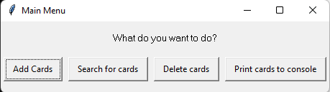
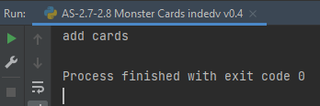
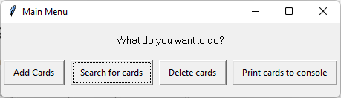
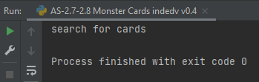
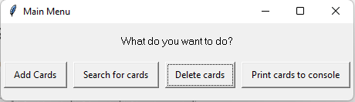
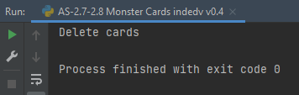
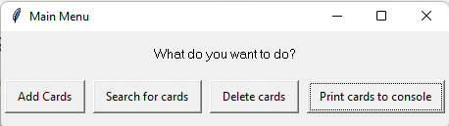
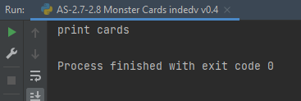
Main Menu: Testing
Everything works as expected.
Notes:
You must show the results of testing. For each component, include a screenshot proving it works. You can also include notes about each test.

Slide 15
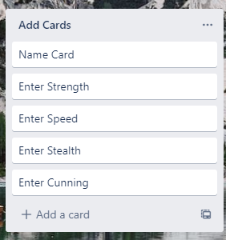
Add Cards (Trello screenshot)

Slide 16
Add Cards - Test Plan
Additional rows can be added by clicking in the last cell and then using the Tab key
Test Cases - input | Expected output
Add a samuel card | Adds the name, then adds stats for each stat
Cancel, enter nothing | Cancels card creation
Enter unexpected values for stats such as -1 and 28, 2.4 | Error, gets me to re-enter the stat value
Notes:
Additional rows can be added by clicking in the last cell and then using the Tab key

Slide 17
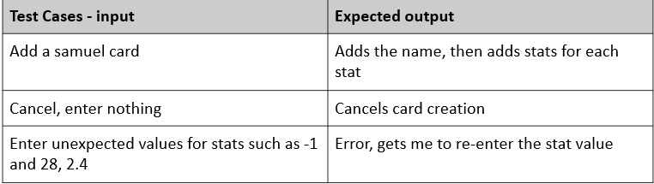
Add Cards: Testing
You must show the results of testing. For each component, include a screenshot proving it works. You can also include notes about each test.
Slide 1
Slide 2
Slide 3
Notes:
You must show the results of testing. For each component, include a screenshot proving it works. You can also include notes about each test.

Slide 18
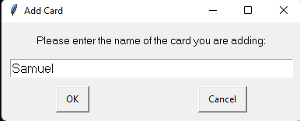
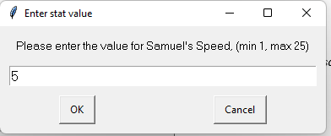
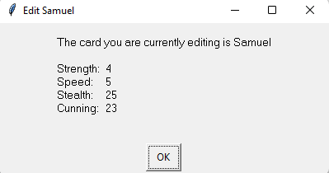
Add Cards: Testing (1)
Everything works as expected
The add cards function asks for the card name, then each of the stats, then allows me to review the stats and edit if necessary
Notes:
You must show the results of testing. For each component, include a screenshot proving it works. You can also include notes about each test.

Slide 19
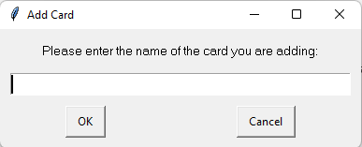
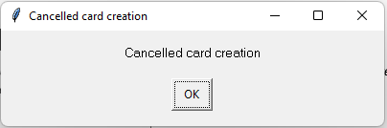
Add Cards: Testing (2)
Everything works as expected
If you don’t enter anything or cancel, it cancels the card creation and returns you to the menu
Notes:
You must show the results of testing. For each component, include a screenshot proving it works. You can also include notes about each test.

Slide 20
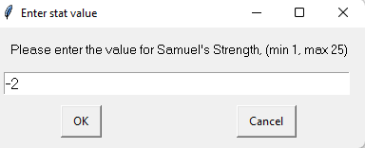
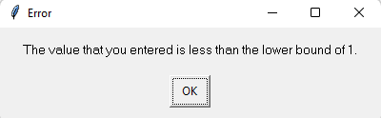
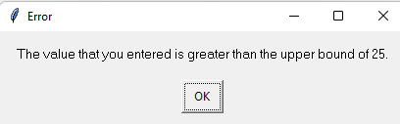
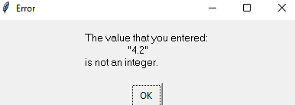
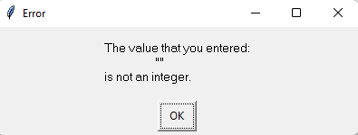
Add Cards: Testing (3)
Everything works as expected
On every value we do not want, the program sends an error message and gets you to re-enter the stat. so everything works as expected
Notes:
You must show the results of testing. For each component, include a screenshot proving it works. You can also include notes about each test.

Slide 21
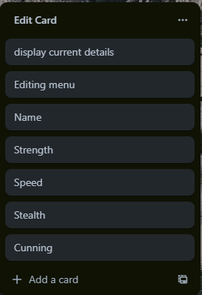
Edit Cards(Trello screenshot)

Slide 22
Edit Cards- Test Plan
For testing purposes I will use the stoneling card
Test Cases - input | Expected output
Cancel | Take me back to main menu (1)
Change name to boneling | Bring me to name change menu, change name, then open menu again and the name should be boneling (2)
Change all stats to 1 | Loops edit menu and changes stats (3)
Check boundaries | Return me to editing (4)
Notes:
Additional rows can be added by clicking in the last cell and then using the Tab key

Slide 23
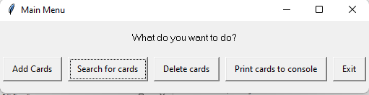
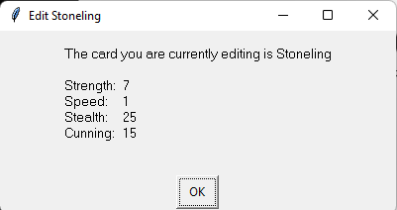
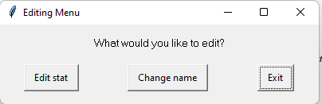
Edit Cards: Testing (1)
Everything works as expected
Notes:
You must show the results of testing. For each component, include a screenshot proving it works. You can also include notes about each test.

Slide 24
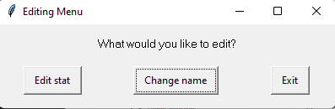
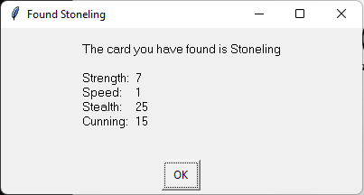
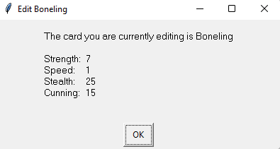
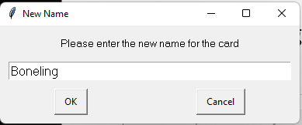
Edit Cards: Testing (2)
Everything works as expected
Notes:
You must show the results of testing. For each component, include a screenshot proving it works. You can also include notes about each test.

Slide 25
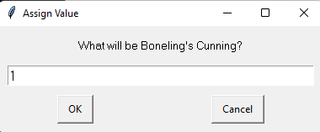
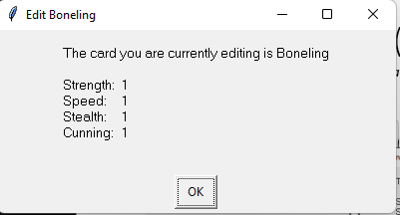
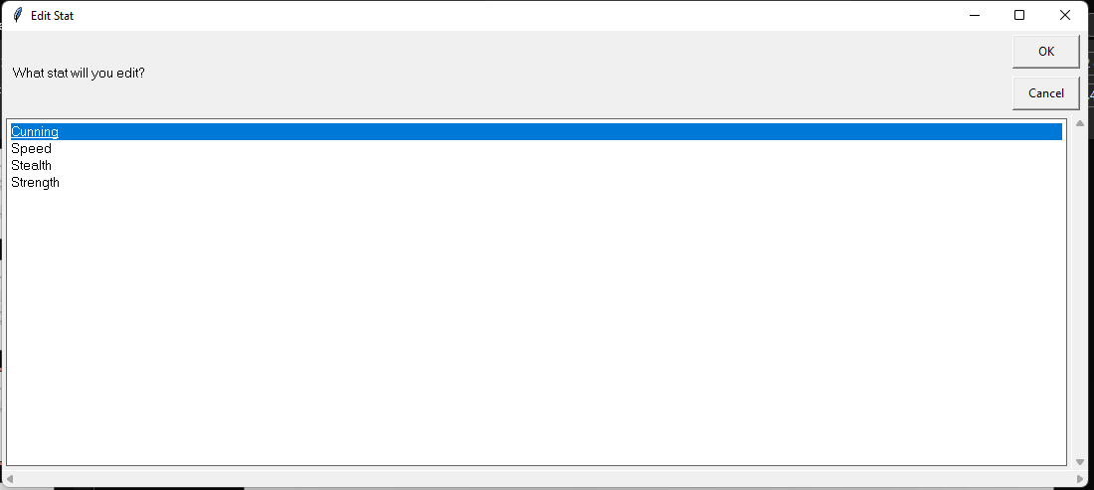
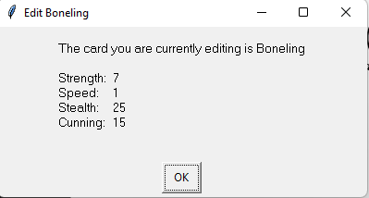
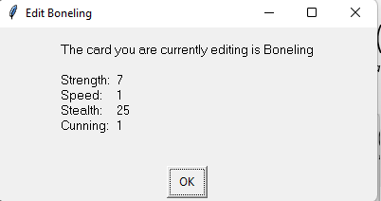

Edit Cards: Testing (3)
Everything works as expected
Notes:
You must show the results of testing. For each component, include a screenshot proving it works. You can also include notes about each test.

Slide 26






Edit Cards: Testing (4)
Everything works as expected
Notes:
You must show the results of testing. For each component, include a screenshot proving it works. You can also include notes about each test.

Slide 27

Find Cards(Trello screenshot)

Slide 28


Find Cards: Trialling
I had a friend test my program and they said it was disorienting to have a choicebox for deleting cards and an enterbox for searching, so I changed to a choicebox for searching
Notes:
NOTE: Trialling needs to happen for at least 2 of your components but is not necessary for ALL components.
Trialling is not the same as testing. Trialling is about finding different ways of building the same component. Show evidence of your trialling here. Select one of your trials for further development and give reasons for your choice.

Slide 29
Find Cards - Test Plan
Additional rows can be added by clicking in the last cell and then using the Tab key
Test Cases - input | Expected output
Cancel search | Take me back to main menu (1)
Choose Stoneling | Allow me to edit, delete, or cancel (2)
Press each option | The respective action happens (3)
Notes:
Additional rows can be added by clicking in the last cell and then using the Tab key

Slide 30



Find Cards: Testing (1)
Everything works as expected
Notes:
You must show the results of testing. For each component, include a screenshot proving it works. You can also include notes about each test.

Slide 31


Find Cards: Testing (2)
Everything works as expected
Notes:
You must show the results of testing. For each component, include a screenshot proving it works. You can also include notes about each test.

Slide 32



Find Cards: Testing (3)
Everything works as expected
Notes:
You must show the results of testing. For each component, include a screenshot proving it works. You can also include notes about each test.

Slide 33

Delete Cards (Trello screenshot)

Slide 34
Delete Cards - Test Plan
Additional rows can be added by clicking in the last cell and then using the Tab key
Test Cases - input | Expected output
Cancel | Cancels
Delete Stoneling | Stoneling is deleted
Notes:
Additional rows can be added by clicking in the last cell and then using the Tab key

Slide 35



Delete Cards: Testing
Everything works as expected
Notes:
You must show the results of testing. For each component, include a screenshot proving it works. You can also include notes about each test.

Slide 36

Print cards to console: (Trello screenshot)
I Changed the Trello as I decided against using a table to have clearer separation between cards

Slide 37
Print Cards to console - Test Plan
Additional rows can be added by clicking in the last cell and then using the Tab key
Test Cases - input | Expected output
Print cards, as default | Prints all cards
Print cards with an added Samuel card and a deleted Stoneling cards | Prints all the right cards
Print with no cards | No cards ae printes
Notes:
Additional rows can be added by clicking in the last cell and then using the Tab key

Slide 38





Print cards to console: Testing
Everything works as expected
Notes:
You must show the results of testing. For each component, include a screenshot proving it works. You can also include notes about each test.

Slide 39

Save/load data(Trello screenshot)

Slide 40
Save/load data : Trialling
I originally made a program without saving data, as the task states that changes do not HAVE to be saved, however it didn’t say changes SHOULD NOT be saved, and so I decided mu program would be better with the option to load and save changes from an external document. And so I trialled both and decided to stick with saving data.
Notes:
NOTE: Trialling needs to happen for at least 2 of your components but is not necessary for ALL components.
Trialling is not the same as testing. Trialling is about finding different ways of building the same component. Show evidence of your trialling here. Select one of your trials for further development and give reasons for your choice.

Slide 41
Save/load data - Test Plan
Test Cases - input | Expected output
Don’t load data, delete all cards, then add a samuel card and save | Data saved (1)
Don’t load data, and print all cards | Normal cards printed (2)
Load data, then print cards | Samuel card printed (3)
Notes:
Additional rows can be added by clicking in the last cell and then using the Tab key

Slide 42



Save/load data: Testing (1)
Everything works as expected
Notes:
You must show the results of testing. For each component, include a screenshot proving it works. You can also include notes about each test.

Slide 43



Save/load data: Testing (2)
Everything works as expected
Notes:
You must show the results of testing. For each component, include a screenshot proving it works. You can also include notes about each test.

Slide 44


Save/load data: Testing (3)
Everything works as expected
Notes:
You must show the results of testing. For each component, include a screenshot proving it works. You can also include notes about each test.

Slide 45




Assembled Outcome Testing:
To Prove that my assembled outcome works, I will run the program, display instructions, not load data, add a samuel card, search for the stoneling card and change its name to boneling, delete the froststep card, print all of the cards and exit saving my data. I will then run the program again, load data, and print the cards.
Notes:
Show testing for your assembled outcome below. This should include a test plan followed by screenshot proof.

Slide 46








Assembled Outcome Testing: (1)
Notes:
Show testing for your assembled outcome below. This should include a test plan followed by screenshot proof.

Slide 47









Assembled Outcome Testing: (2)
Notes:
Show testing for your assembled outcome below. This should include a test plan followed by screenshot proof.

Slide 48



Assembled Outcome Testing: (3)
Notes:
Show testing for your assembled outcome below. This should include a test plan followed by screenshot proof.

Slide 49








Assembled Outcome Testing: (4)
Notes:
Show testing for your assembled outcome below. This should include a test plan followed by screenshot proof.

Slide 50



Assembled Outcome Testing: (4)
Everything works as expected
Notes:
Show testing for your assembled outcome below. This should include a test plan followed by screenshot proof.

Slide 51
Address relevant Implications:
Relevant implication | Explain how your final outcome addresses each implication
Functionality | I have addressed functionality by comprehensively testing my program throughout the development process including relevant boundary inputs and unexpected inputs
Usability | I have addressed usability by making sure my program has clear instructions and is easy to use. I had peers use the program and give me feedback on this, and I have improved my program throughout using their advice
Aesthetics | I have made sure that all of the messages are well formatted, as well as using a GUI for aesthetic purposes.
Future proofing | I have added comments throughout my code so that any programmer could easily understand what is happening at any point and I have added doc strings at the top of each version

Slide 52


Version Control Evidence:
Your version control evidence should go here. This could be in the form of screenshots (both of your GitHub repository as well as your local project folder) as evidence of your incremental development.
Notes:
Your version control evidence should go here. This could be in the form of screenshots (both of your GitHub repository as well as your local project folder) as evidence of your incremental development.

Slide 53
Final Discussion:
While developing this program, planned, tested, and trailed its components and then later as a whole working Monster card program, as shown in my evidence I tested every component, checking the program worked correctly on the boundary and unexpected inputs, and I trialed Main Menu, search cards and the ability to save/load data by making two solutions for the same problem then choosing the better one.
By decomposing the problem, I was able to plan my program efficiently and was able to focus on creating and testing small chunks of code. Each of these chunks was thoroughly tested during and after construction, as you can see from my Trello board and the Trello decomposition slide for each component. I then used this to manage my time and take on small chinks of code one at a time, allowing me to create a comprehensive program in the selected timeframe.
By testing, was able to find and fix the flaws in my program before combining them into the full program, as you can see in each component, such as when I added none checkers to take care of accidental entry of nothing and checked if there were cards when deleting cards to avoid unwanted errors that crash the program.
Having volunteers test my program enabled me to further improve its functionality and get ideas about how to make it better which raised the reliability and quality of the finished program, such as when I had some of my peers use the Program and give me feedback, which included the search cards being disorienting and the instructions not clear enough, which led me to change the search for cards and to change the instructions.
User feedback enabled me to look at the program from a non-programmer's point of view. This, combined with the information I got from the earlier Planning, testing, and trailing, enabled me to produce a high-quality program. This program is resilient to errors and crashing on unexpected inputs.
Notes:
Discuss how the information from planning, testing and trialling of components assisted in the development of a high-quality outcome.

Slide 54

PEP 8 Checking
PyCharm has a built-in PEP8 checker, so I used that to check that my code meets the PEP8 requirements, and as you can see here there are no errors except for the “Typos” that have been introduced from the names of the cards.

